Slide 1
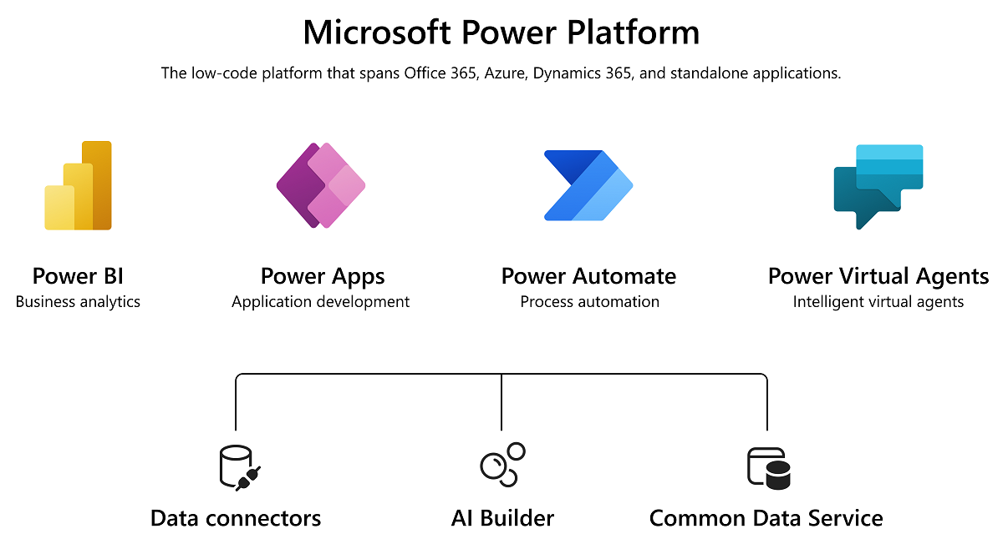
Introduction to Microsoft Power Platform
A low-code & Pro platform enabling users to build apps, automate processes, analyze data, and create websites with minimal coding.

Slide 2
Components Overview
Power Apps – Build custom business apps.
Power Automate – Automate workflows.
Power BI – Visualize data.
Power Pages – Create websites for external users .
Power Virtual Agents-AI Powered intelligent Chatbots & Agents
Dataverse – Secure enterprise data storage.

Slide 3
Power Apps Types
Canvas Apps: full design freedom.
Model-driven Apps: based on data structure. Examples: Leave request app, ticket management app.

Slide 4
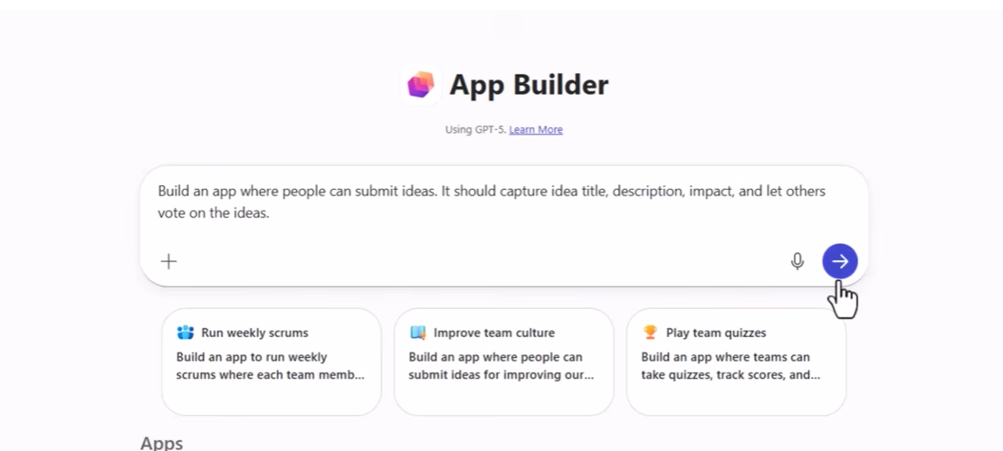
No code Vs Low code Vs Vibe Vs Pro
No‑Code
Microsoft 365 App Builder
Build apps using natural language prompts
Automatically generates data tables, screens, and forms
Ideal for business users and rapid prototyping
Low‑Code
Canvas Apps & Model‑Driven Apps
Canvas Apps: Full visual design control with drag‑and‑drop UI
Model-Driven Apps: Data model–driven apps built on Dataverse
Ideal for makers building business workflows and forms

Slide 5
Vibe Code (AI-Assisted Development)
Vibe.PowerApps.com + Gen Pages
AI helps generate screens, layouts, and formulas
Modern interface for accelerated app building
Produces consistent UI experiences using “Vibes”
Pro‑Code
Developer Extensions
Create custom components using PCF
Integrate APIs, Azure Functions & custom connectors
Full development support in VS Code & Power Platform CLI
Ideal for pro developers extending the platform

Slide 6
Power Automate
Automates repetitive tasks such as approvals, notifications, and integrations. Example: Auto-email when SharePoint item is created.

Slide 7
Power BI
Used for interactive dashboards and analytics. Example: Sales dashboard tracking KPIs across regions.

Slide 8
Power Pages
Used to build secure external-facing websites. Example: Customer service portal for ticket logging.

Slide 9
Dataverse
Cloud-based data storage offering tables, relationships, security. Example: Central store for employee or customer data.

Slide 10
Use Cases & Examples
HR onboarding automation, Expense approval workflows, Inventory management apps, Financial dashboards.

Slide 11
Licensing Overview
Power Apps per-app/per-user plans, Power Automate per-flow or user plans, Power BI Pro/Premium licensing.

Slide 12
Environments
Default – personal use.
Sandbox – testing & QA.
Production – live business usage.

Slide 13
Solution-based Development
Packages all components for ALM. Includes flows, apps, tables. Used for migration & versioning.

Slide 14
PowerApps Collections
A collection is simply a Table of values.
Collections have rows, columns and cells just like a table in Excel does
All values in a column must be of the same data type (example: text, number, date, true/false)
The maximum number of rows that can be imported into a collection at once is 500 rows by default but this can be increased to 2,000 by changing the delegation limit
Example:
ClearCollect(myCities1, {City: "New York", Country: "USA", Continent: "North America"}, {City: "London", Country:"United Kingdom", Continent: "Europe"}, {City: "Kyoto", Country: "Japan", Continent: "Asia"}, {City: "Osaka", Country: "Japan", Continent: "Asia"}, {City: "Los Angeles", Country: "USA", Continent: "North America"}, {City: "Paris", Country: "France", Continent: "Europe"}, {City: "Birmingham", Country:"United Kingdom", Continent: "Europe"} );

Slide 15
PowerApps Collection Advantages
A collection can be created from the values in a SharePoint List, Excel Spreadsheet, SQL, CDS or any other datasource, Manually with static data.
Collections only exist while an app is running. When the app is closed the data stored in a collection no longer exists.
Rows from a collection can be inserted back into the original datasource to change its values
Galleries, Forms and Data Tables can use a collection as the datasource
Using collections as a datasource can reduce loading times because data is stored on the local device rather than in the cloud.
Once a collection is created it can be accessed from any screen.

Slide 16
Collect Vs ClearCollect Vs Clear
Collect():
Adds new records to a collection without removing existing data.
Collect(
EmployeeList,
{ ID: 1, Name: "Ravi", Dept: "IT" }
);
✔ Adds a record to EmployeeList ✔ Existing records remain untouched
Clear()
Removes all records from a collection
Clear(EmployeeList);
ClearCollect()
Clears the collection → then adds new records in a single step. Most commonly used in apps.
ClearCollect(
EmployeeList,
{ ID: 1, Name: "Ravi" },
{ ID: 2, Name: "shankar" }
);

Slide 17
Types of PowerApps Variables
Understanding Variables
A variable in the context of Power Apps is a storage location that temporarily holds data while the app is running
Think of a variable as a labeled container where you can store a piece of information that you might need to reference or manipulate later.
Types of Data Stored in Variables:
Variables can store various types of data, including:
Text: Strings of characters, such as names or messages.
Numbers: Numerical values for calculations or counters.
Booleans: True or false values for conditions.
Records: Structured data that can contain multiple fields, like a database row.
Tables: Collections of records, similar to a spreadsheet.

Slide 18
Importance of Variables in Power Apps
Variables are crucial in Power Apps for several reasons:
Data Management: They allow you to store and manage data dynamically. For example, you can store user input in a variable and use it later in your app without having to fetch the data again from a data source.
Improving Performance: By using variables to cache data, you can reduce the number of calls to data sources, which can significantly improve the performance of your app. This is especially important in apps that handle large amounts of data or need to operate efficiently on mobile devices.
State Management: Variables help in managing the state of your application. For instance, you can use variables to keep track of whether a user is logged in, the current step in a multi-step form, or the visibility of certain UI elements.
Conditional Logic: They enable you to implement complex conditional logic. You can use variables to store the results of conditional checks and then use those variables to control the flow of your application, such as showing or hiding elements based on user actions.
Simplifying Code: By storing intermediate results in variables, you can simplify your formulas and make your code more readable and maintainable. This is particularly useful in complex calculations or when the same value needs to be used multiple times in different places.

Slide 19
Power Apps Standards: Variable Types
Variable Scope A variable’s scope determines where it can be referenced in the app. If the variable is required on multiple screens use a global variable. Otherwise, use a local or context variable instead. Choose the proper variable type by determining its scope.
Variable Type | Declaration Method | Scope
Global | Set Function | Variable is available across all app screens
Local | UpdateContext Function | Variable is only available on a single app screen
One-time | With Function | Variable is only available inside the WITH function

Slide 20
Power Fx Formulas
With Function lets you define one or more temporary variables (locals) and then use them within a single formula block. It’s perfect for:
Avoiding repeated calculations (better readability & performance)
The first argument is a record of name/value pairs (your local variables).
The second argument is any expression that can use those local names.
One-time variables are not persistently stored in memory. After the With function is executed the variable is cleared from memory and cannot be accessed outside of the function
Example 1:
With(
{ Price: 1200, DiscountPct: 0.1, Discount: 1200 * 0.1 },
Price - Discount
)
Example 2:
With(
{
Base: 500,
TaxRate: 0.18,
TaxAmount: Base * TaxRate,
Total: Base + TaxAmount
},
Total
)

Slide 21
Global Variables
Set Function To use variables across two (or more) screens in Power Apps, the best method is to use global variables with the Set() function.
Set() variables are global → available everywhere throughout the app
Set(VariableName, Value)
Set(varCounter, 1)
Set(varName, "Lily")
Set(varPerson, { Name: "Milton", Address: "1 Main St" })
Screen1 → Button.OnSelect
Set(TotalAmount, Value(TextInputAmount.Text))
Screen2 → Label.Text
"Your total is: ₹" & TotalAmount

Slide 22
Context(Local) Variable
UpdateContext() is used to create or update context variables in canvas apps. Context variables are local variables that exist only on the current screen.
They are perfect for:
Storing temporary values
Toggling UI elements
Managing form states
Passing values within a screen
Syntax:
UpdateContext({ VariableName: Value })
Show more lines
VariableName → name of your context variable
Value → the value you want to assign
OnSelect property of a button:
UpdateContext({ showPopup: true })
``

Slide 23
Navigate function
Navigate() Function in Power Apps
The Navigate() function is used to move from one screen to another.
TargetScreen → the screen you want to open
TransitionType → animation effect (optional)
Common transition types:
ScreenTransition.None
ScreenTransition.Fade
ScreenTransition.Cover
ScreenTransition.UnCover
Navigate from Screen1 to Screen2
Button on Screen1 → OnSelect
Navigate(Screen2, ScreenTransition.Fade)

Slide 24
Concurrent function : function lets you run multiple independent formulas at the same time (in parallel). It’s useful when you want to reduce screen/app load time by not waiting for one operation to finish before starting the next—especially for data calls and collections.
Concurrent(
Formula1,
Formula2,
...,
FormulaN
)
When to use Concurrent
Loading multiple tables/collections on app OnStart or screen OnVisible.
Performing several API/data source calls simultaneously.
Doing multiple Patches/Collects that don’t rely on each other.
Initializing context/global variables in parallel.

Slide 25
Concurrent function
Concurrent function
Load multiple data sources in parallel (Screen OnVisible or App OnStart)
Concurrent(
ClearCollect(colProducts, Filter(Products, IsActive)),
ClearCollect(colCustomers, Customers),
ClearCollect(colOrders, Filter(Orders, Status = "Open")),
Set(gstRate, 0.18)
Parallel API calls into separate collections
Concurrent(
ClearCollect(colWeather, WeatherConnector.GetToday(LocationInput.Text)),
ClearCollect(colNews, NewsConnector.TopHeadlines("manufacturing")),
ClearCollect(colAlerts, AlertsConnector.GetAlerts(User().Email))
);
)

Slide 26
Connecting Data Sources
SharePoint for lists, Dataverse for structured tables, SQL for enterprise data. Examples: Connecting Power Apps to SharePoint list for CRUD.

Slide 27
Hands-On Exercises
1. Build Canvas & Model-driven app.
2. CRUD operations with SharePoint/Dataverse.
3. Add validations using Power Fx.

